Slide 1
The Collaborative Futures Project: A Road to Shared Next Generation Library Systems
OLA Super Conference 2017

Slide 2
Introduction to OCUL & The Collaborative Futures Project

Slide 3
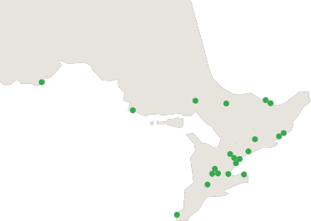
Ontario Council of University Libraries
OCUL is a consortium of Ontario’s 21 university libraries.
Nipissing
Laurentian
Algoma
Lakehead
Trent
York
Guelph
Waterloo
Wilfrid Laurier
Western
Windsor
Carleton
Ottawa
Queen’s
RMC
UOIT
Ryerson
Toronto
OCADU
Brock
McMaster
Notes:
OCUL, or the Ontario Council of University Libraries, is a consortium of all the libraries at Ontario’s 21 universities. It has a province wide reach from Lakehead University to the University of Windsor in the south and reaching as far east as Ottawa and Carleton in Ottawa and of course all the universities in between.

Slide 4
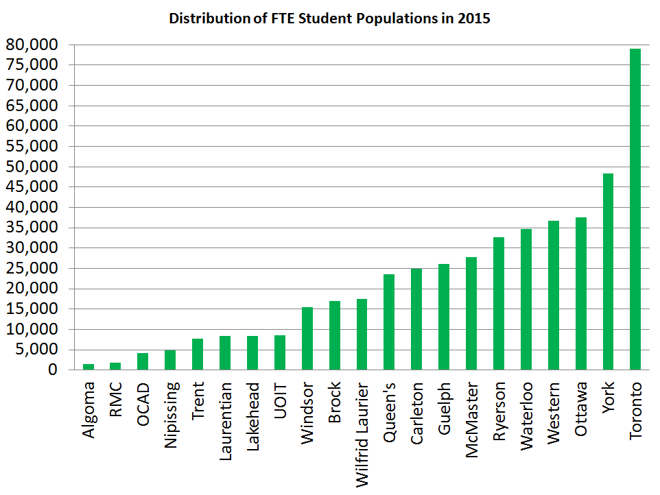
Notes:
The total university student population in Ontario is over 466,000 – this is about 1/3 of all the university students in Canada.
As you can see the population at the Ontario universities varies considerably. So there is a diversity of needs for our members and their communities.

Slide 5
Thinking OCULy
Thinking and working together for common benefit
Collaborate. Innovate. Deliver.
Collections
Scholars Portal
Member Services
Notes:
The universities come together through OCUL to do many things, all focused around three core principles: Collaboration, Innovation and Service Delivery.
The key OCUL activities include:
Collections - Licensing e-resources on behalf of members
Scholars Portal - shared technological infrastructure
Member services - which includes collaborative planning, advocacy, professional development, partnerships and research.
The impact of OCUL’s collaboration isn’t just about the collective outcomes. By coming together and discussing ideas, innovations, practices, this knowledge is also often taken back to individual institutions and implemented at a local level. OCUL is a hub for innovation and knowledge sharing that then moves outwards and is put into a local context.
Like any organization of this type, OCUL’s success is due to committed member involvement. OCUL endeavors to make it as easy as possible for all university libraries to be involved, and for its activities to be fair and equitable.

Slide 6
Collaborative Futures Vision
A distributed and shared collaborative approach to print and electronic/digital resource management.
The keys to achieving the vision include:
Implement shared next generation library services platforms (LSPs).
Collaborate to manage and preserve print resources in a sustainable system.
Collaborate to effectively use shared systems to manage electronic & print resources.
Notes:
The vision is defined by the existence of a distributed and shared collaborative approach to print and electronic/digital resource management. This approach builds upon existing OCUL-wide collaborative initiatives such as Scholars Portal technology and collaborative licensing.
The keys to achieving the vision include:
Implement shared next generation library services platforms.
Collaborate to manage and preserve print resources in a sustainable system.
Collaborate to effectively use shared systems to manage electronic & print resources.

Slide 7
Collaborative Futures Phases
Phase 1: Feasibility Study - complete
Phase 2: Developing system requirements and preparing for procurement - underway
Phase 3: Procurement and implementation at participating libraries
Phase 3 to begin in early 2017
Notes:
Flexible participation.
Project Scope
To accomplish the vision, a multi-phase project has been planned.
Phase 1: Feasibility Study - Completed (November 2014 - July 2015)
In this first phase, the project focused on developing a business case to demonstrate the benefits and costs for collaboration in the three key areas. At the end of this phase, OCUL presented information to member libraries to determine if they would like to proceed to the next Phase.
In April 2015, as part of this first phase OCUL requested information from software vendors and other organizations interested in and able to provide creative, innovative, and future-driven solutions to help us achieve our Collaborative Futures vision. A copy of this Request for Information (RFI) is available as a PDF. At the end of this phase there was strong support from Directors for OCUL to move forward to Phase 2 of the Collaborative Futures project.
Phase 2: Developing System Requirements and Preparing for Procurement – wrapping up (August 2015 – )
Phase 2 has focused on further investigation and planning for the possible implementation of a shared next-generation library services platform to provide grounding for deeper collaboration. The 18 institutions that have opted to participate in Phase 2 are contributing expertise, staff time on working groups or teams and support to the project. Activities in this Phase have focused on achieving project funding, preparing requirements for technology acquisition, further market exploration and building our agreements for collaboration.
At the end of Phase 2, member libraries will have the option to decide whether to move toward procurement and implementation of a shared system.
Phase 3: Procurement and Implementation at Libraries (Winter 2017– Winter 2018)
If Phase 3 is approved, the participating libraries will be fully engaged in the activities to acquire a shared library services platform, plan for data migrations, implement new work flows and prepare for live participation.

Slide 8
Phase 2 Deliverables
Business plan (budget, funding models, timeline)
Market sounding (costing, product demonstrations)
User and technical requirements for shared LSP
Memorandum of Understanding

Slide 9
Where others have gone before…
Within OCUL:
Tri-University Group (TUG) – Guelph, Waterloo, Wilfrid Laurier
Evergreen consortium – Algoma, Laurentian
Across Canada:
Ontario Colleges Library Service – Sirsi consortium
NEOS (Alberta)
Novanet (Nova Scotia)
Bureau de coopération interuniversitaire (Québec)

Slide 10
The Project Team
Project Manager
Steering Committee (“Shared Vision Task Force” or SVTF)
Working groups – Phase 1
Market Research
Total Cost of Ownership
Shared Print Management and Preservation
Shared Workflow/Business Processes
Communications
Working groups – Phase 2
MOU
Shared LSP Requirements
Communications

Slide 11
Panelists Today
Anika Ervin-Ward (OCUL), Communications Working Group Chair
Amy Greenberg (OCUL), Collaborative Futures Project Manager
Sandra Morden (Queen’s), Shared LSP Requirements Working Group Chair
Catherine Steeves (Western), SVTF member-at-large
Mabel Wang (OCUL), Procurement Consultant
Wade Wyckoff (McMaster), MOU Working Group Chair
Notes:
Steering Committee members (Shared Vision Task Force)

Slide 12
Collaborative Futures Vision and Project Outcomes

Slide 13
The Vision
By 2020, OCUL envisions our users experiencing a large, diverse Ontario-wide library collection rather than the collection at their specific institution. They can move seamlessly between different types of content (electronic and print, books and journals, etc.) using multiple interoperable platforms whose design is evidence-based. Via search engine optimization and advanced authentication, many users experience OCUL resources from outside of Ontario. Users have access to more books and specialized content than ever before, and these resources are incorporated into their research, learning and teaching workflows.
Notes:
In the Fall of 2014 a project charter was developed which included this vision statement for the project

Slide 14
The Vision cont’d
By 2020, OCUL library employees will perceive collaborative work as a given – they are part of a network and naturally work within it. They are likely to work on a daily basis with staff at other OCUL libraries, and are familiar with OCUL wide standards and policies. They may be doing work on behalf of another institution for the good of the OCUL community, and participate in opportunities for job sharing, secondments and exchanges within OCUL libraries.
Notes:
No mention of specific technology – this is deliberate.

Slide 15
Collaboration Outcomes
Shared LSP with common configuration
Allow for local differences where necessary
Build collaboration from the start, enable for future
Shared record loading
Shared records and ERM
Shared Discovery, OCUL view
Seamless Interlibrary loan/request and fulfillment
Shared analytics, e.g. OCUL-wide collection analysis
Shared patron services and policies
And full range of LSP requirements
Notes:
Foundation for building the CF vision – short-term, mid-term, long-term

Slide 16
Thanks!
More info
Visit the Collaborative Futures website: http://www.ocul.on.ca/projects/collaborative-futures
Contact us:
ocul@ocul.on.ca

